Slide 1
Introduction to Devops

Slide 2
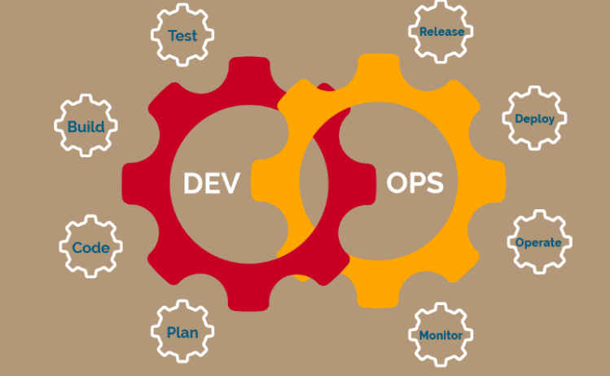

Slide 3
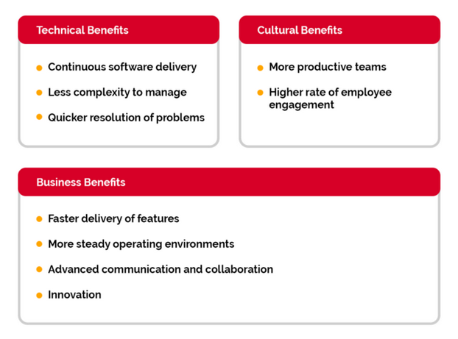
Why You Need DevOps?

Slide 4
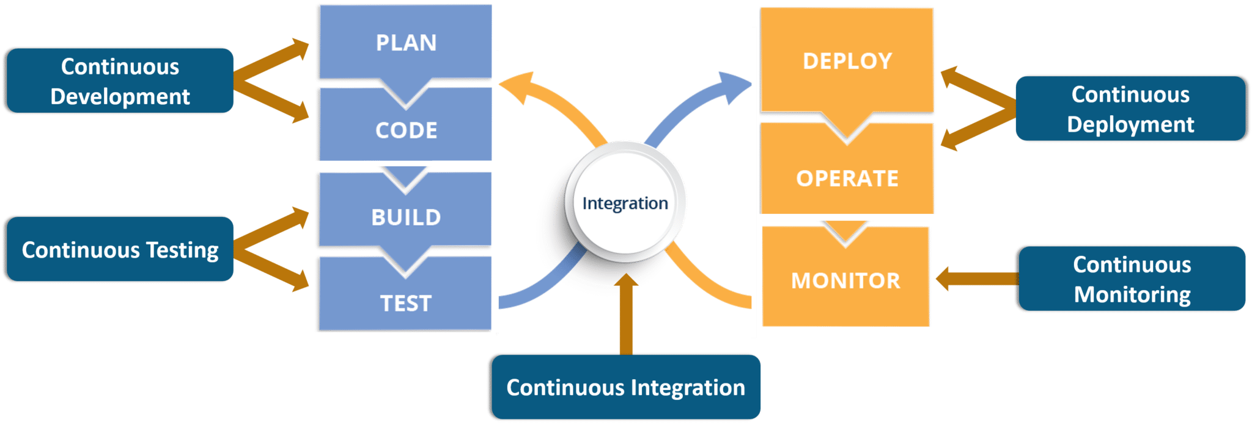

Slide 5
DevOps ecosystem
Plan
This stage is composed of two phases: Define and Plan. This stage refers to the business value and application requirements. Considering agile process, you should use tools that allow your development team to plan in iterations. You can learn from the users at an early stage and can optimize the product. Always consider tools that offer sprint planning features. During this stage, it is necessary that everyone can share and discuss anything: ideas, strategies, goals, requirements, roadmaps, and documentation. This phase includes:
Production metrics, objects and feedback
Requirements
Business metrics
Update release metrics
Release plan, timing and business case
Security policy and requirement
Tools used: JIRA ,Rally, Trac, Redmine

Slide 6
2. Create
The second phase of DevOps is create. This is comprised of building, coding, and configuring the development process. Tools used in this category often overlap with other categories. As DevOps is breaking silos down, this impact the activities and solutions. Activities which comes under this stage are:
Design of the software and configuration
Coding including code quality and performance
Software build and build performance
Release candidate
Tools used: Gradle, Apache Maven, Grunt, WebPack, Github, Bitbucket, Docker, BuildMaster, Slack

Slide 7
3. Test
Testing is one of those functionalities which had shift left due to DevOps. The quality aspect of the software depends on the efficiency of testing. As continuous integration has numerous goals for the testing phase, testing should be always automated to assure a seamless flow, sharp and detailed results, and fair affirmation of the application. Early stage testing, initial validation and frequent testing ensure quality built-in to the application can be verified and issues to be tackled early. Testing is directly associated with ensuring the quality of the software release; activities designed to ensure code quality is maintained and the highest quality is deployed to the production. The main activities in this are:
Acceptance testing
Regression testing
Security and vulnerability analysis
Performance
Configuration testing
Tools used: JIRA issue tracking, Bugzilla, Selenium, Mocha, Jasmine, JUnit, NUnit, JMeter, pytest, BlazeMeter, Load Impact

Slide 8
4. Packaging
Packaging phase starts once the release is ready for deployment. This stage is often referred to as Preproduction/preprod. The packaging stage comprises tools for package repositories and other storage mechanisms for the binaries created in the development stage. Repositories, also known as artifact or asset repositories — include all assets needed and connected with binaries to facilitate the deployment, such as scripts, configuration files, and additional infrastructural files. Packaging consists of following activities;
Approval/preapprovals
Package configuration
Triggered releases
Release staging and holding
Tools used: Dockers, consul.io, Ansible, SaltStack, Puppet, Chef

Slide 9
5. Release
Release includes schedule, orchestration, provisioning and deploying software into production and targeted environment. Part of this process is application release automation tools that help up the packaging and deploying the application from development to production, using automation. The specific Release activities include:
Release coordination
Deploying and promoting applications
Fallbacks and recovery
Scheduled/timed releases
Tools: Jenkins, Kubernetes CI/CD
Jenkins is an open source automation server that offers a plugin architecture to support continuous integration and delivery. It integrates with a variety of software tools in the CI/CD toolchain and distributes work across multiple platforms. In DevOps, Jenkins is been used for packaging, release, and configuration.
Kubernetes is an open-source platform for automating deployments, scaling, and operations of application containers across clusters of hosts, providing container-centric infrastructure.
Other tools used: Dockers, Docker Hub, Docker Swarm, Travis CI, consul.io, Ansible, SaltStack, Puppet, Chef

Slide 10
6. Configure
Configure comes under the operation side of DevOps. Once the software is deployed, you need additional IT infrastructure and configuration. Configuration tools aim to allow the creation of better applications with flexibility, less downtime, and enhancing an overall cost effectiveness for the business. This approach is intended to reduce as many things creating complexity as possible by removing manual configurations. Automation and collaboration are the epicenters in DevOps and this is the reason why configuration is also widely automated across development flows. Specific configuration activities include;
Infrastructure storage, database and network provisioning and configuring
Application provision and configuration
Tools used: Dockers, Jenkins, Kubernetes CI/CD, consul.io, Ansible, SaltStack, Puppet, Chef

Slide 11
7. Monitor
Monitoring is an essential section in a DevOps process. It allows IT team to identify specific issues of specific releases and to know the impact on end-users. There is also an important aspect of making sure organization gets (only) valid data about the process, results in each step, and the outcome.
Monitor related activities are:
Performance of IT infrastructure
End-user response and experience
Production metrics and statistics
Tools: New Relic
New Relic is SaaS web and mobile application performance monitoring tool that gives analytics from the customer experience perspective. It monitors availability, alerting, and notifications in real time for applications running in the cloud, on-premise, or hybrid environments.
Other tools used: Firebase Analytics, crashlytics, ELK stack — Data/BI analytics, Sumologic, Nagios, JIRA, Telegram, Slack

Slide 12
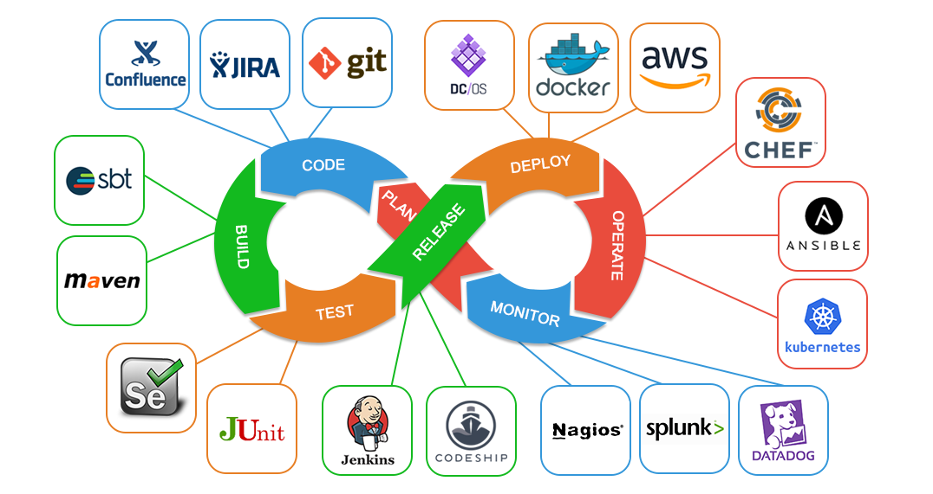
DevOps ecosystem

Slide 13
Introduction to Devops

Slide 14
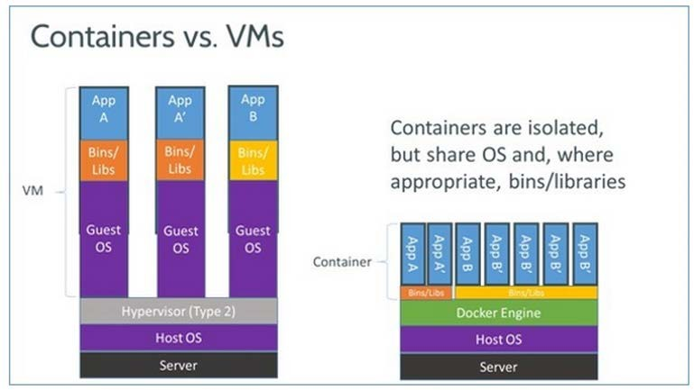
Docker containers

Slide 15
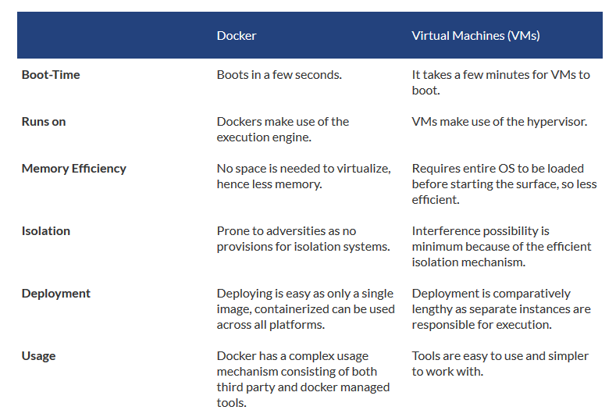

Slide 16
Docker
Docker is a very light-weight software container and containerization platform
Docker containers provide a way to run software in isolation
What does a Docker Container contain and provide?
Initially – only a base Linux operating system
A boundary or a “jail” to contain running software
Like a good jail, there are no unauthorized entries or exits
A Docker Image is the foundation for any particular Docker container
What is outside of Docker?
Other Docker containers
The operating system, kernel
Any other operating software

Slide 17
Docker
Docker is computer software used for Virtualization in order to have multiple Operating systems running on the same host. Unlike Hypervisors which are used for creating VM (Virtual machines), virtualization in Docker is performed on system-level in so-called Docker containers.
Docker containers run on top of the host's Operation system. This helps you to improves efficiency. Moreover, we can run more containers on the same infrastructure than we can run Virtual machines because containers use fewer resources.

Slide 18
Docker was originally a Linux application
Docker for Linux
It uses the kernel container functionality
It requires a 64 bit installation using a
kernel version 3.10 or later
Docker runs on many popular Linux distributions
It is available as RPM, APT, or binary
versions

Slide 19
Docker runs natively on OS X
Docker for OS X
DMG install application running in user space
Is built on the xhyve hypervisor
Requires a 2010 or newer Mac with Intel MMU and
EPT support
Requires OS X 10.10.3 Yosemite or newer
Requires at least 4GB of RAM

Slide 20
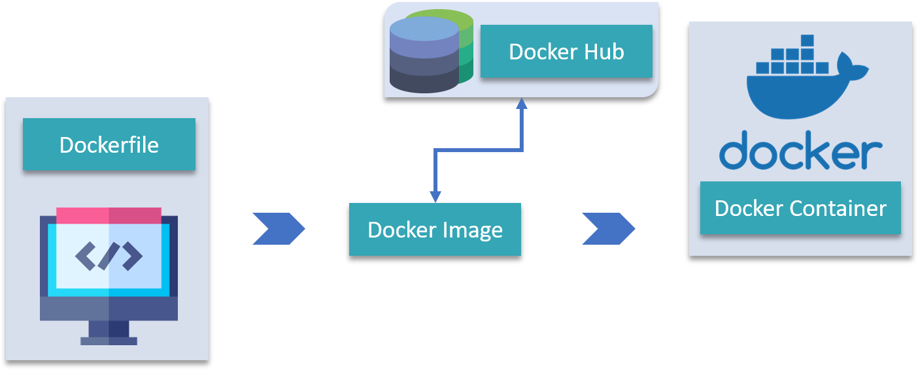

Slide 21
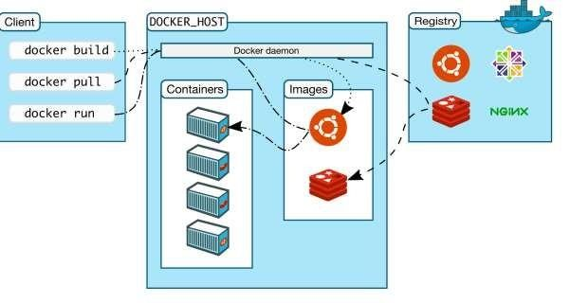
Docker Architecture
Docker uses a client-server architecture
Client
Is the primary user interface which
communicates using a REST API
Over HTTP
Over local Unix socket
•
Server
Is the Docker daemon
Responsible for building, running, and distributing containers
Registry
Responsible for the storage, management, and delivery of Docker Images
Docker Hub
Private
Other vendors

Slide 22
Running Containers
The docker `run` command starts a container based on a named Docker Image
Docker first looks for a local copy of the image
o If it does not exist it is pulled from a Docker Registry
o The default Registry is the Docker Hub Registry
A new container is created using the file system from the image
A read-write layer is added to the top of the file system
A network interface is created and an IP address is assigned from a pool
Standard input, output, and error streams are connected
A specified application is executed
o Docker container appears as a child of the daemon process, ms are connected

Slide 23
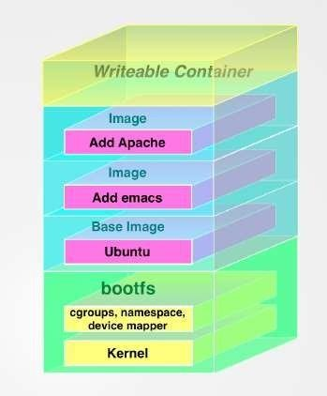
Docker Images & Containers
Docker images are read-only templates
Foundation is a simplified version of the Linux operating system
Changes to foundation, such as application installations
added to the Image
Images are the templates or build commands for Docker
Docker containers are running environments
Has OS, environment, program, network, etc.
Runs (probably one) application
All required software contained in image
Can have boot-up configuration
They can be run, started, stopped, and deleted

Slide 24
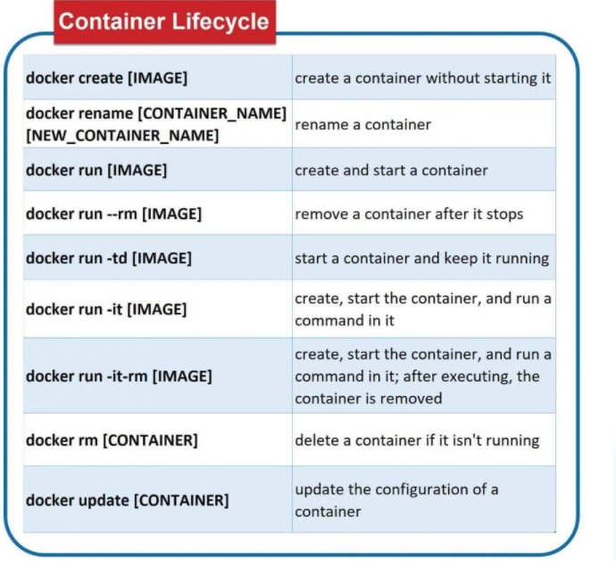

Slide 25
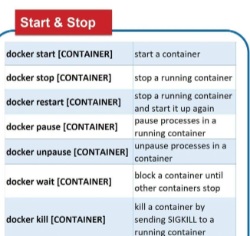

Slide 26
